Slide 1
Outline
Series and Parallel Resonator
Unloaded, External, and Loaded Q
Transmission Line Resonators
Rectangular Waveguide Cavity Resonator
Dielectric Resonator
Resonator Q and Filter Loss

Slide 2
Series Resonator

Slide 3
Parallel Resonator

Slide 4
Unloaded, External, and Loaded Q

Slide 5
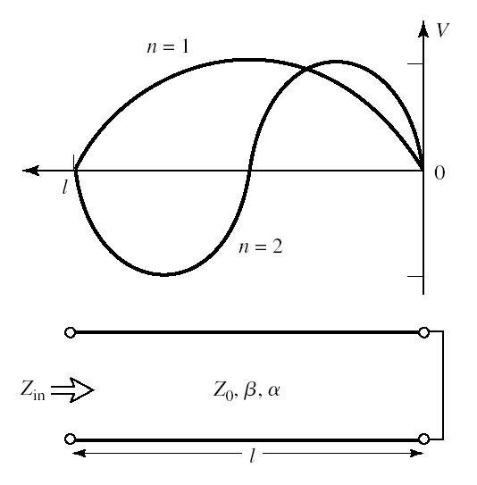
Transmission Line Resonators
Short circuited λ/2 line
This is equivalent to a series resonator

Slide 6
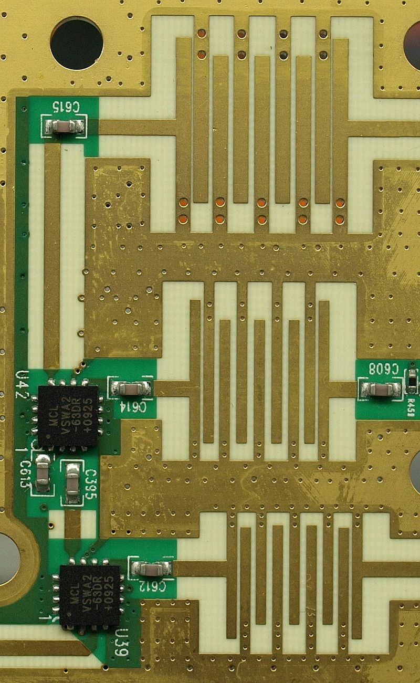
Transmission Line Resonators
Short circuited λ/4 line
This is equivalent to a parallel resonator

Slide 7
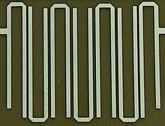
Transmission Line Resonators
Open circuited λ/2 line
This is equivalent to a parallel resonator

Slide 8
Transmission Line Resonators
Metal loss
Radiation loss
Dielectric loss

Slide 9
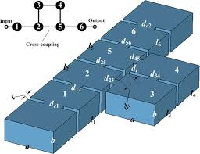
Rectangular Waveguide Cavity

Slide 10
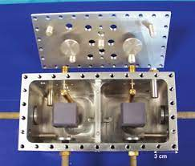
Dielectric Resonator
Full-wave simulations are necessary

Slide 11
Resonator Q and Filter Loss

Slide 12
Resonator Q and Filter Loss

